Slide 1
The Analysis and Design of Computer Algorithms
CIS*3490 Winter 2021

Slide 2
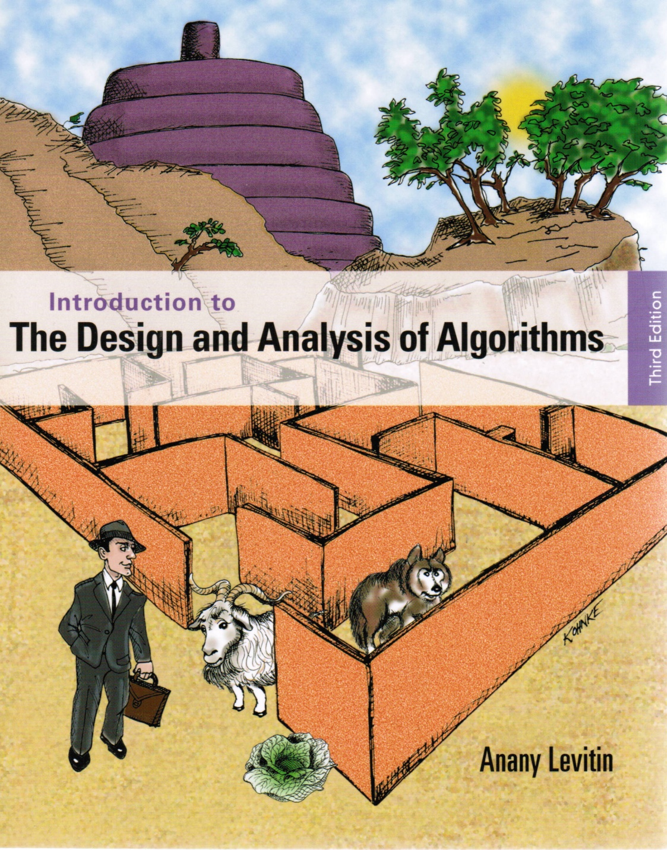
Chapter 5
Divide and
Conquer

Slide 3

Divide-and-Conquer Technique
Problem instance
of size n
The most-well known algorithm design strategy:
Divide instance of problem into two or more smaller instances
Solve smaller instances recursively
Obtain solution to the original (larger) instance by combining these solutions to smaller instances.
Sub-instance 1
of size n/2
Sub-instance 2
of size n/2
a solution to
Sub-instance 1
a solution to
Sub-instance 2
a solution to the original
problem instance

Slide 4
Divide-and-Conquer Examples
Sorting: mergesort and quicksort
Binary tree traversal
Algorithm for multiplication of large integers
Matrix multiplication: Strassen’s algorithm
Convex-hull algorithms

Slide 5
Mergesort
Split array A[0..n-1] into two about equal size halves and make copies of each half in arrays B and C
Sort arrays B and C recursively
Merge sorted arrays B and C into array A as follows:
Repeat the following until no elements remain in one of the arrays:
compare the first elements in the remaining unprocessed portions of the arrays
copy the smaller of the two elements into A, while incrementing the index indicating the unprocessed portion of that array
Once all elements in one of the arrays are processed, copy the remaining unprocessed elements from the other array into A.

Slide 6
Mergesort Example
1
5
2 3 8 9
1 4 5 7
2 3 8 9
1 4 5 7
1 2 3 4
2
6
2 3 8 9
1 4 5 7
2 3 8 9
1 4 5 7
1
1 2 3 4 5
3
7
2 3 8 9
1 4 5 7
2 3 8 9
1 4 5 7
1 2
1 2 3 4 5 7
4
8
2 3 8 9
1 4 5 7
2 3 8 9
1 4 5 7
1 2 3
1 2 3 4 5 7 8 9
Notes:
Go over this example in detail, then do another example of merging, something like:
(1 2 5 7 9)
(3 4 6)

Slide 7
Mergesort Example
1
5
2 3 8 9
1 4 5 7
2 3 8 9
1 4 5 7
1 2 3 4
2
6
2 3 8 9
1 4 5 7
2 3 8 9
1 4 5 7
1
1 2 3 4 5
3
7
2 3 8 9
1 4 5 7
2 3 8 9
1 4 5 7
1 2
1 2 3 4 5 7
4
8
2 3 8 9
1 4 5 7
2 3 8 9
1 4 5 7
1 2 3
1 2 3 4 5 7 8 9
Notes:
Go over this example in detail, then do another example of merging, something like:
(1 2 5 7 9)
(3 4 6)

Slide 8
Mergesort Example
1
5
2 3 8 9
1 4 5 7
2 3 8 9
1 4 5 7
1 2 3 4
2
6
2 3 8 9
1 4 5 7
2 3 8 9
1 4 5 7
1
1 2 3 4 5
3
7
2 3 8 9
1 4 5 7
2 3 8 9
1 4 5 7
1 2
1 2 3 4 5 7
4
8
2 3 8 9
1 4 5 7
2 3 8 9
1 4 5 7
1 2 3
1 2 3 4 5 7 8 9
Notes:
Go over this example in detail, then do another example of merging, something like:
(1 2 5 7 9)
(3 4 6)

Slide 9
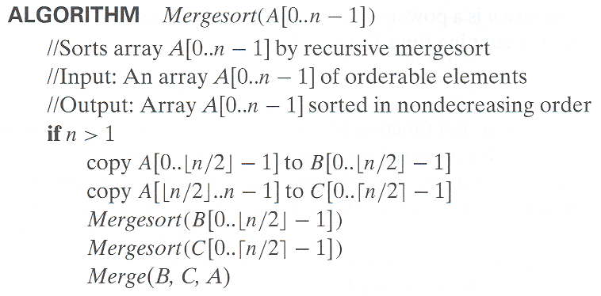
Pseudocode of Mergesort

Slide 10
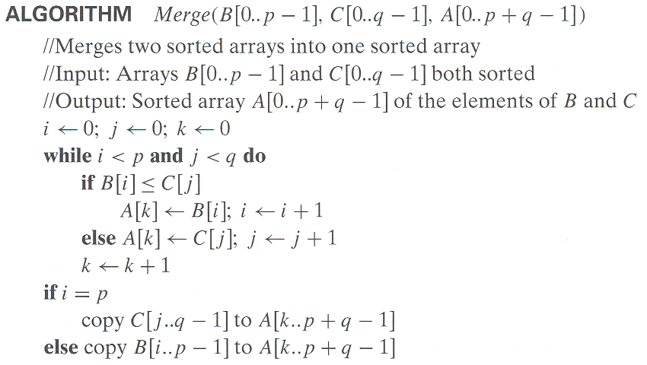
Pseudocode of Merge

Slide 11
Numbers of Comparisons for Merging
Best Case:
2 1 4 3 8 6 7 5
1 2 3 4 5 6 7 8
i -> i -> i -> i j
Number of comparisons: n/2
Worst Case:
7 1 5 3 8 6 2 4
1 3 5 7 2 4 6 8
i -> i -> i -> i j -> j -> j -> j
Number of comparisons: n - 1

Slide 12
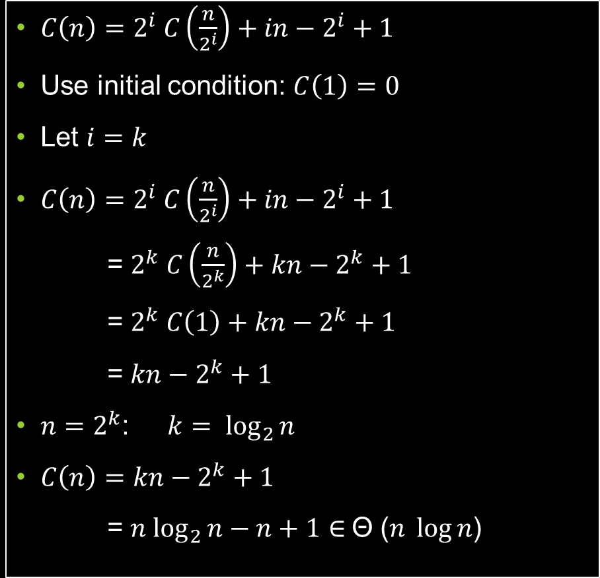
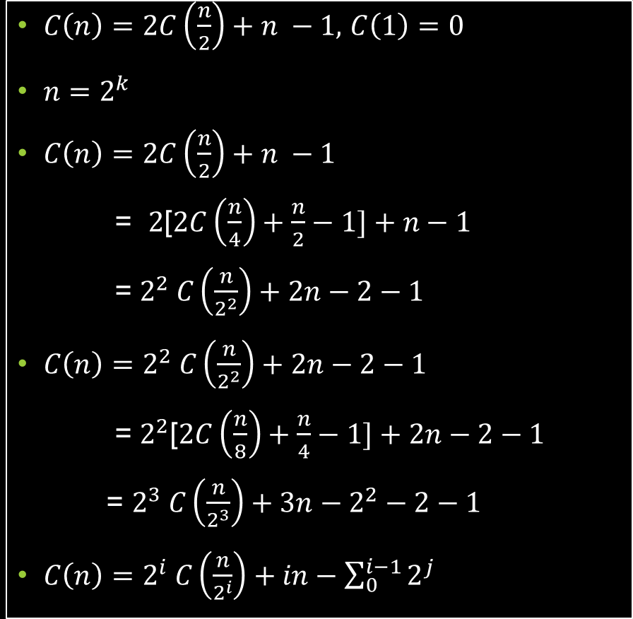
Analysis of the Worst Case
$C\left(n\right)=2C\left(\frac{n}{2}\right)+n −1,$ $C\left(1\right)=0$
$n=2^{k}$
$C\left(n\right)=2C\left(\frac{n}{2}\right)+n −1$
= $2$[$2C\left(\frac{n}{4}\right)+\frac{n}{2}−1]+n−1$
= $2^{2} C\left(\frac{n}{2^{2}}\right)+2n−2−1$
$C\left(n\right)=2^{2} C\left(\frac{n}{2^{2}}\right)+2n−2−1$
= $2^{2}$[$2C\left(\frac{n}{8}\right)+\frac{n}{4}−1]+2n−2−1$
= $2^{3} C\left(\frac{n}{2^{3}}\right)+3n−2^{2}−2−1$
$C\left(n\right)=2^{i} C\left(\frac{n}{2^{i}}\right)+in−\sum_{0}^{i−1}{2^{j}}$
$C\left(n\right)=2^{i} C\left(\frac{n}{2^{i}}\right)+in−2^{i}+1$
Use initial condition: $C\left(1\right)=0$
Let $i=k$
$C\left(n\right)=2^{i} C\left(\frac{n}{2^{i}}\right)+in−2^{i}+1$
= $2^{k} C\left(\frac{n}{2^{k}}\right)+kn−2^{k}+1$
= $2^{k} C\left(1\right)+kn−2^{k}+1$
= $kn−2^{k}+1$
$n=2^{k}$: $k= \log_{2}{n}$
$C\left(n\right)=kn−2^{k}+1$
= ${n log}_{2}{n−n+1}$ $∈$Θ ($n \log{n}$)

Slide 13


Analysis of the Best Case
$C\left(n\right)=2C\left(\frac{n}{2}\right)+\frac{n}{2},$ $C\left(1\right)=0$
$n=2^{k}$
$C\left(n\right)=2C\left(\frac{n}{2}\right)+\frac{n}{2}$ = $2$[$2C\left(\frac{n}{4}\right)+\frac{n}{4}]+$ $\frac{n}{2}$
= $2^{2} C\left(\frac{n}{2^{2}}\right)+\frac{n}{2}+\frac{n}{2}$ = $2^{2} C\left(\frac{n}{2^{2}}\right)+2(\frac{n}{2})$
$C\left(n\right)=2^{2} C\left(\frac{n}{2^{2}}\right)+2(\frac{n}{2})$ = $2^{2}$[$2C\left(\frac{n}{8}\right)+\frac{n}{8}]+$ 2($\frac{n}{2})$
= $2^{3} C\left(\frac{n}{2^{3}}\right)+3(\frac{n}{2})$
$C\left(n\right)=2^{i} C\left(\frac{n}{2^{i}}\right)+i(\frac{n}{2})$
Use initial condition: $C\left(1\right)=0$
Let $i=k$
$C\left(n\right)=2^{i} C\left(\frac{n}{2^{i}}\right)+i(\frac{n}{2})$ = $2^{k} C\left(\frac{n}{2^{k}}\right)+k(\frac{n}{2})$
= $2^{k} C\left(1\right)+k(\frac{n}{2})$ = $2^{k} ×0+k(\frac{n}{2})$
= $k(\frac{n}{2})$
$n=2^{k}$: $k= \log_{2}{n}$
$C\left(n\right)=k(\frac{n}{2})$ = ${\frac{1}{2}n log}_{2}{n}$ $∈$Θ ($n \log{n}$)

Slide 14

Efficiency of Mergesort
Worst case:
$C_{worst}\left(n\right)=2C_{worst}\left(\frac{n}{2}\right)+n−1$
$C_{worst}\left(1\right)=0$
$C_{worst}\left(n\right)=2^{i}C_{worst}\left(n/2^{i}\right)+i(n)−\sum_{j=0}^{i−1}{2^{j}}$
$C_{worst}\left(n\right)=n\log_{2}{n}−n+1$ ∈ Θ(n log n)
Best case:
$C_{best}\left(n\right)=2C_{best}\left(\frac{n}{2}\right)+ \frac{n}{2}$
$C_{best}\left(1\right)=0$
$C_{best}\left(n\right)=2^{i}C_{best}\left(n/2^{i}\right)+i(\frac{n}{2})$
$C_{best}\left(n\right)=\frac{1}{2}n\log_{2}{n}$ ∈ Θ(n log n)
All cases have same efficiency: Θ(n log n)
Notes:
even if not analyzing in detail, show the recurrence for mergesort in worst case:
T(n) = 2 T(n/2) + (n-1)
worst case comparisons for merge

Slide 15
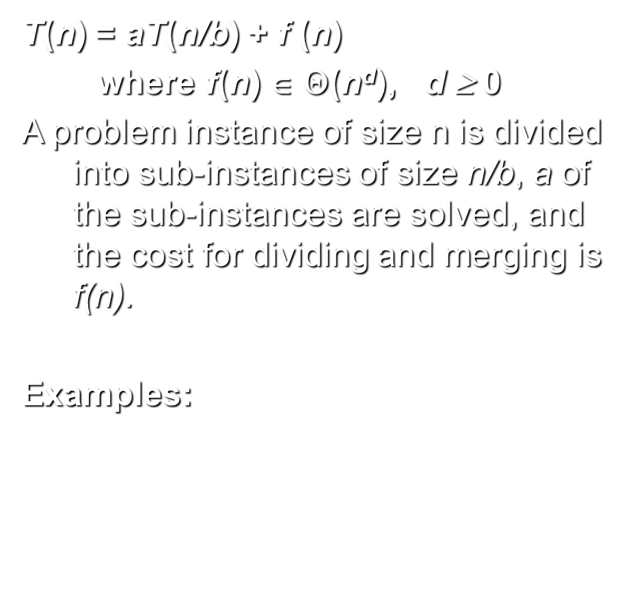
General Divide-and-Conquer Recurrence
T(n) = aT(n/b) + f (n)
where f(n) ∈ Θ(n^{d}), d ≥ 0
A problem instance of size n is divided into sub-instances of size n/b, a of the sub-instances are solved, and the cost for dividing and merging is f(n).
Examples:
$C_{worst}\left(n\right)=$ ${2C}_{worst }\left(\frac{n}{2}\right)+n −1$
$C_{best}\left(n\right)=2C_{best}(\frac{n}{2}) +\frac{n}{2}$
Recursive divide and conquer algorithm
T(n) = aT(n/b) + f (n)
backward
substitution
T(n) = function of n
T(n) ∈ Θ(g(n))

Slide 16
General Divide-and-Conquer Recurrence
T(n) = aT(n/b) + f (n)
where f(n) ∈ Θ(n^{d}), d ≥ 0
A problem instance of size n is divided into sub-instances of size n/b, a of the sub-instances are solved, and the cost for dividing and merging is f(n).
Master Theorem:
If a < b^{d}, T(n) ∈ Θ(n^{d})
If a = b^{d}, T(n) ∈ Θ(n^{d} log n)
If a > b^{d}, T(n) ∈ Θ(n^{log b a} )
Note: The same results hold with O.
Recursive divide and conquer algorithm
T(n) = aT(n/b) + f (n)
backward
Master substitution
Theorem
T(n) = function of n
T(n) ∈ Θ(g(n))

Slide 17
General Divide-and-Conquer Recurrence
T(n) = aT(n/b) + f (n) where f(n) ∈ Θ(n^{d}), d ≥ 0
Master Theorem: If a < b^{d}, T(n) ∈ Θ(n^{d})
If a = b^{d}, T(n) ∈ Θ(n^{d} log n)
If a > b^{d}, T(n) ∈ Θ(n^{log b a} )
Examples: T(n) = 4T(n/2) + n ⇒ T(n) ∈ ?
a = 4, b = 2, d = 1, b^{d} = b¹ = 2¹= 2, a > b^{d}
T(n) ∈ Θ(n^{log b a} ) = Θ(n^{log 2 4} ) = Θ(n^{log 2 4} ) = Θ(n² )
T(n) = 4T(n/2) + n² ⇒ T(n) ∈ ?
T(n) = 4T(n/2) + n³ ⇒ T(n) ∈ ?

Slide 18
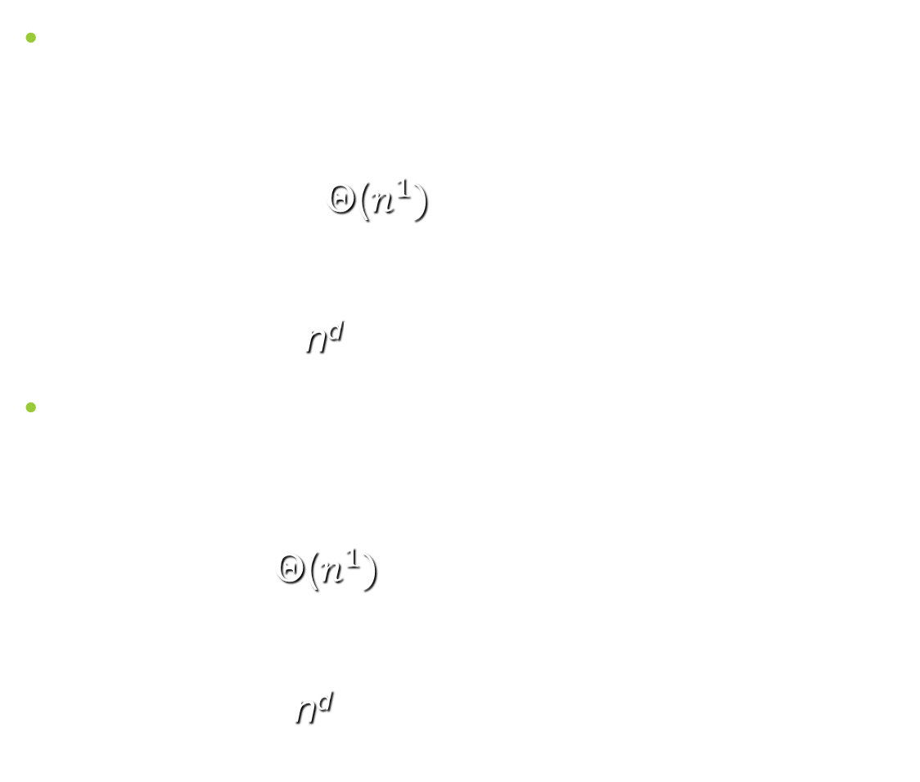
Efficiency of Mergesort by Master Theorem
Worst case:
$C_{worst}\left(n\right)=2C_{worst}\left(\frac{n}{2}\right)+n−1$, $C_{worst}\left(1\right)=0$
$f\left(n\right)=n−1∈$ Θ($n^{1})$, $a=2, b=2, d=1$
$b^{d}=2^{1}=2=a$
$C_{worst}\left(n\right)$∈ Θ(n^{d}log n) = Θ(n log n)
Best case:
$C_{best}\left(n\right)=2C_{best}\left(\frac{n}{2}\right)+ \frac{n}{2}$, $C_{best}\left(1\right)=0$
$f\left(n\right)=n/2∈$ Θ($n^{1})$, $a=2, b=2, d=1$
$b^{d}=2^{1}=2=a$
$C_{best}\left(n\right)$ ∈ Θ(n^{d} log n) = Θ(n log n)
T(n) = aT(n/b) + f (n)
where f(n) ∈ Θ(n^{d}), d ≥ 0
Master Theorem:
If a < b^{d}, T(n) ∈ Θ(n^{d})
If a = b^{d}, T(n) ∈ Θ(n^{d} log n)
If a > b^{d}, T(n) ∈ Θ(n^{log b a} )
Notes:
even if not analyzing in detail, show the recurrence for mergesort in worst case:
T(n) = 2 T(n/2) + (n-1)
worst case comparisons for merge

Slide 19
Quicksort
Select a pivot (partitioning element) – here, the first element
Rearrange the list so that all the elements in the first s positions are smaller than or equal to the pivot and all the elements in the remaining n-s positions are larger than or equal to the pivot (see next slide for an algorithm)
Exchange the pivot with the last element in the first (i.e., ≤) subarray — the pivot is now in its final position
Sort the two subarrays recursively
p
A[i]≤p
A[i]≥p

Slide 20
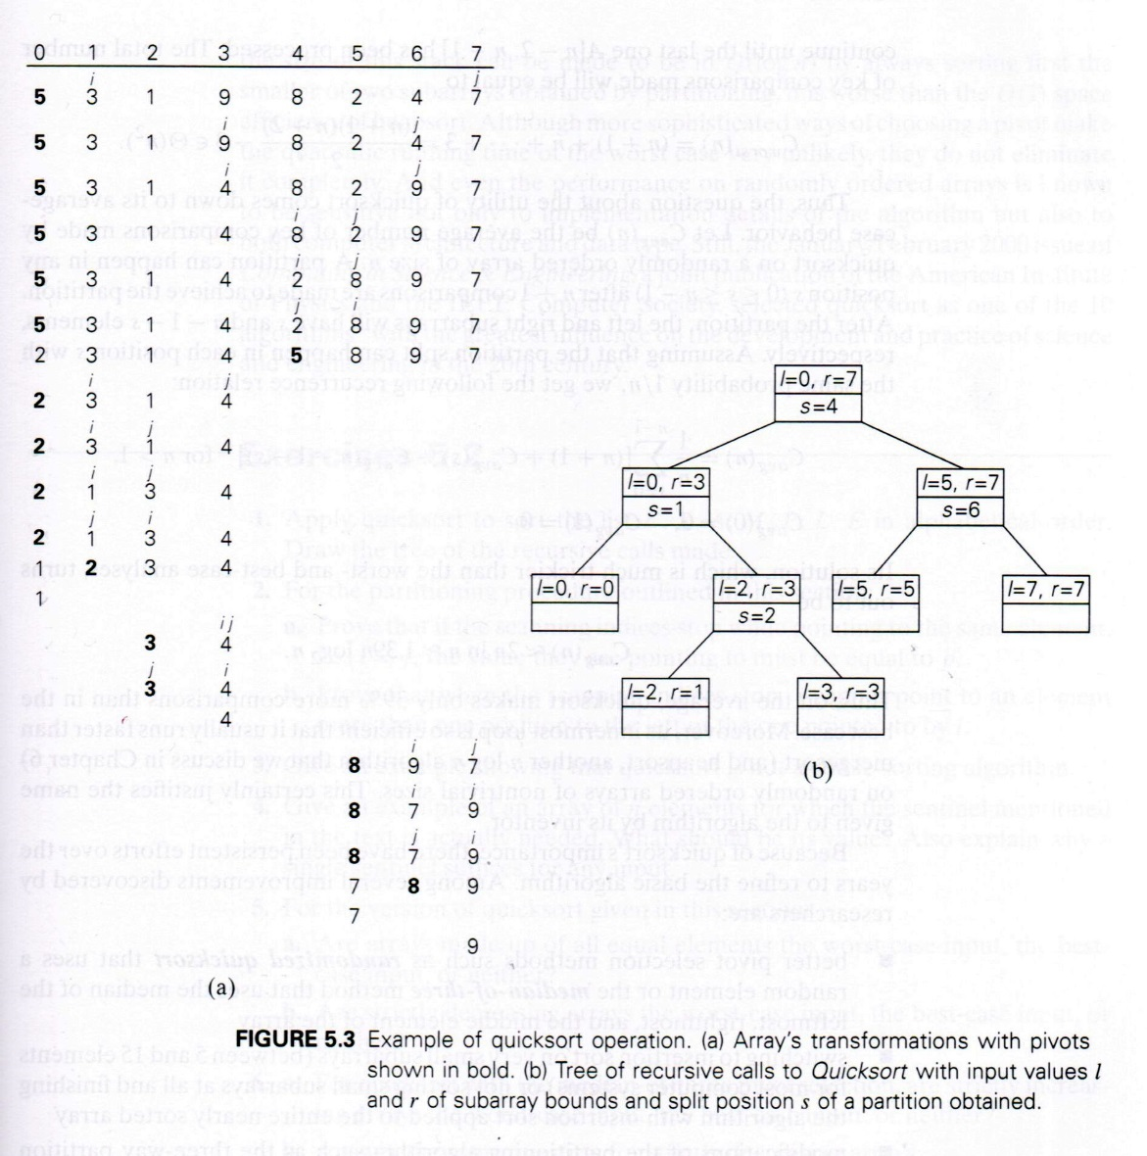
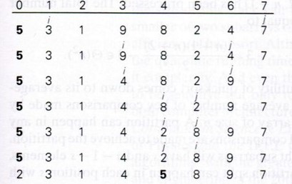
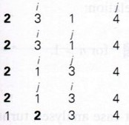
Example of quicksort
1
2
3
4
5
6
7

Slide 21
Example of quicksort
1
2
3
4
5

Slide 22
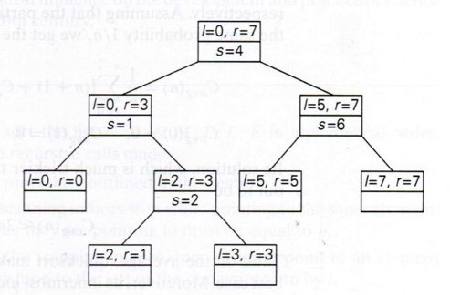
Example of quicksort

Slide 23
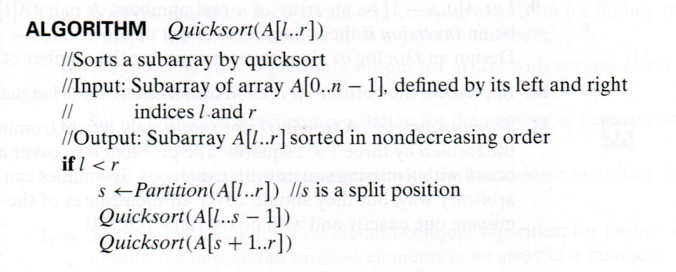
Quicksort Algorithm

Slide 24
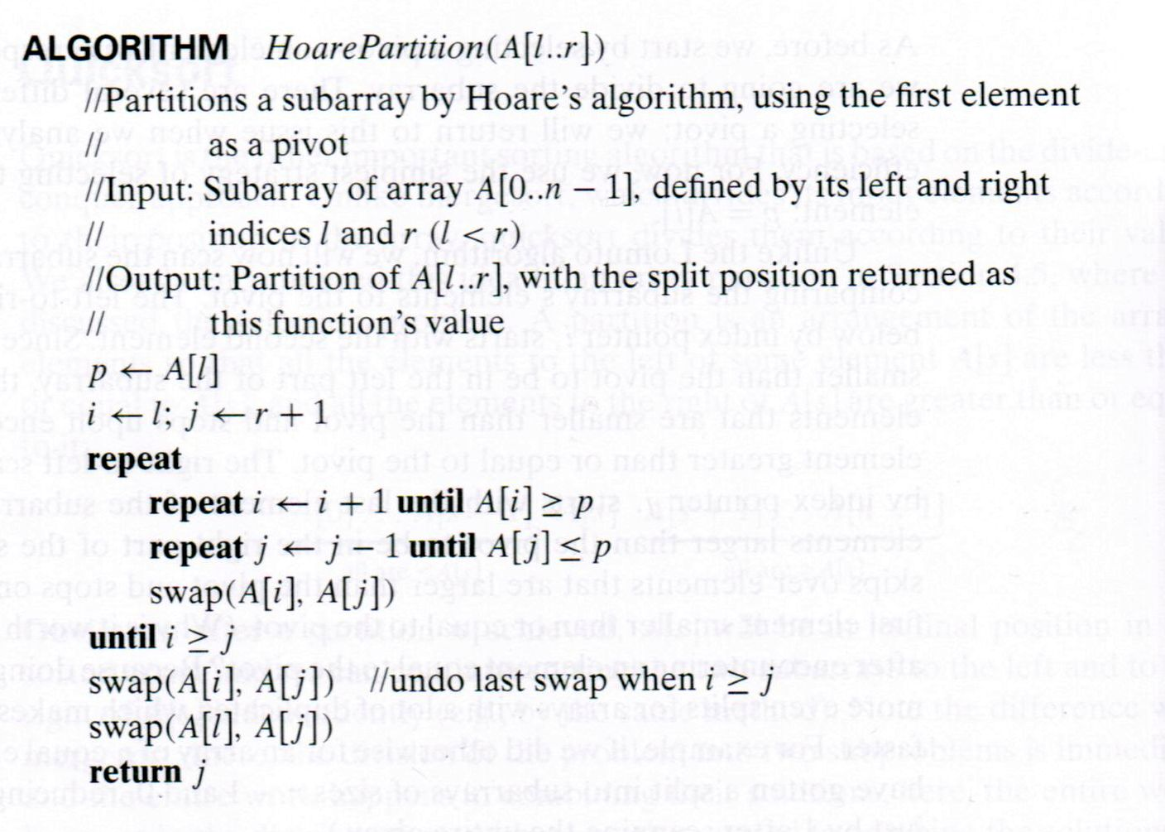
Partitioning Algorithm for Quicksort

Slide 25
Worst Case of Quicksort
i j
1 2 3 4 5 6 7 8
p
j i
1 2 3 4 5 6 7 8
p
i j
1 2 3 4 5 6 7 8
p
j i
1 2 3 4 5 6 7 8
p
i j
1 2 3 4 5 6 7 8
p
j i
1 2 3 4 5 6 7 8
p
1
4
5
2
3
6

Slide 26
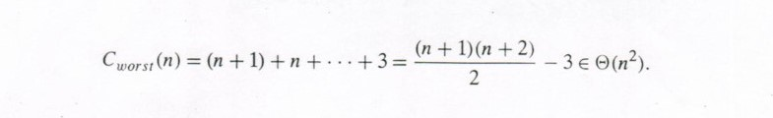
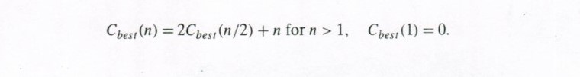
Efficiency of Quicksort

Slide 27
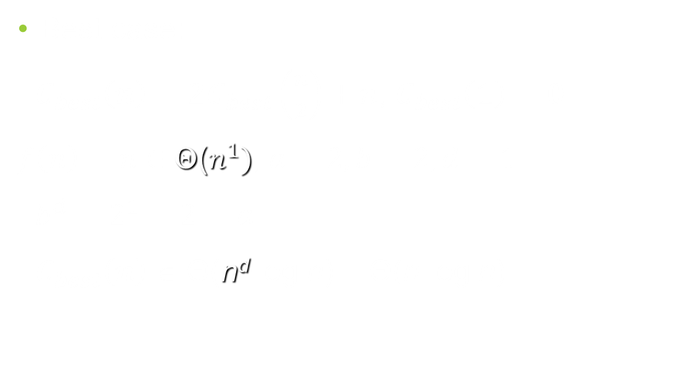
Efficiency of Quicksort by Master Theorem
T(n) = aT(n/b) + f (n)
where f(n) ∈ Θ(n^{d}), d ≥ 0
Master Theorem:
If a < b^{d}, T(n) ∈ Θ(n^{d})
If a = b^{d}, T(n) ∈ Θ(n^{d} log n)
If a > b^{d}, T(n) ∈ Θ(n^{log b a} )
Best case:
$C_{best}\left(n\right)=2C_{best}\left(\frac{n}{2}\right)+n$, $C_{best}\left(1\right)=0$
$f\left(n\right)=n∈$ Θ($n^{1})$, $a=2, b=2, d=1$
$b^{d}=2^{1}=2=a$
$C_{best}\left(n\right)$ ∈ Θ(n^{d} log n) = Θ(n log n)

Slide 28
Analysis of Quicksort
Best case: split in the middle — Θ(n log n)
Worst case: sorted array! — Θ(n²)
Average case: random arrays — Θ(n log n)

Slide 29
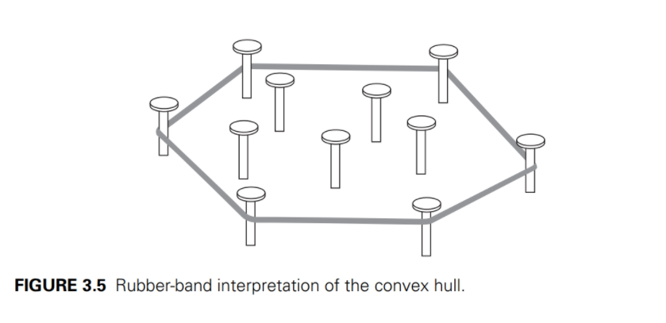
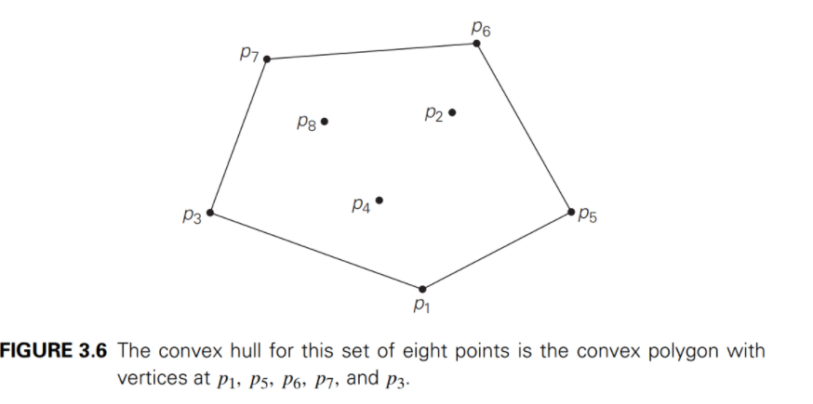
Convex Hull Problem
Convex hull: smallest convex set that includes given points.
Let S be a set of points. The vertices of the convex polygon of S are points in S.
An extreme point is a point in S, and is an endpoint of a line segment of the convex polygon of S.
The convex hull problem is to find all the extreme points.

Slide 30
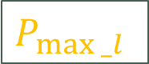
Quickhull Algorithm
Convex hull: smallest convex set that includes given points
Assume points are sorted by x-coordinate values
Identify extreme points P₁ and P₂ (leftmost and rightmost)
Compute upper hull recursively:
find point P_{max_u} that is farthest away from line P₁P₂
compute the upper hull of the points to the left of line P₁ P_{max_u}
compute the upper hull of the points to the left of line P_{max_u} P₂
Compute lower hull in a similar manner
P_{max_u}
P₂
P₁
$$P_{max⁡_l}$$

Slide 31
Efficiency of Quickhull Algorithm
Finding point farthest away from line P₁P₂ can be done in linear time
Time efficiency:
worst case: Θ(n²) (as quicksort)
average case: Θ(n log n) (as quicksort)
best case Θ(n log n) (as quicksort)
If points are not initially sorted by x-coordinate value, this can be accomplished in O(n log n) time
Several O(n log n) algorithms for convex hull are known

Slide 32
Binary Tree Algorithms
Binary tree is a divide-and-conquer ready structure!
Example 1: Classic traversals (preorder, inorder, postorder)
Algorithm Inorder(T)
if T ≠ ∅ a
Inorder(T_{left}) b c
print(root of T) d e
Inorder(T_{right})
Efficiency: Θ(n)

Slide 33
Binary Tree Algorithms (cont.)
Example 2: Computing the height of a binary tree
h(T) = max{h(T_{L}), h(T_{R})} + 1 if T ≠ ∅
h(∅) = -1
Efficiency: Θ(n)

Slide 34
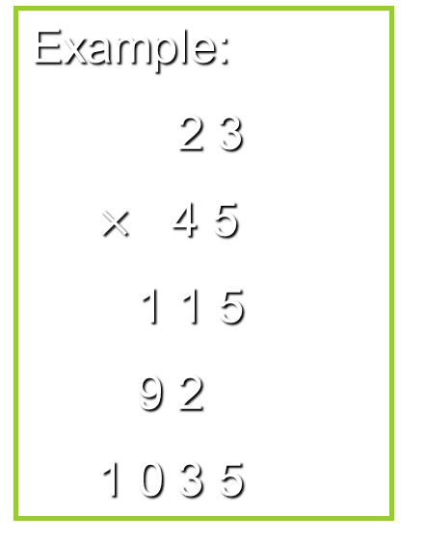
Multiplication of Large Integers
Consider the problem of multiplying two (large) n-digit integers represented by arrays of their digits such as: A = 12345678901357986429 B = 87654321284820912836 The grade-school algorithm:
a₁ a₂ … a_{n} b₁ b₂ … b_{n} (d₁₀) d₁₁d₁₂ … d_{1n}
(d₂₀) d₂₁d₂₂ … d_{2n}
… … … … … … …
(d_{n0}) d_{n1}d_{n2} … d_{nn}
Efficiency: n² one-digit multiplications
Example:
2 3
$×$ 4 5
1 1 5
9 2
1 0 3 5

Slide 35
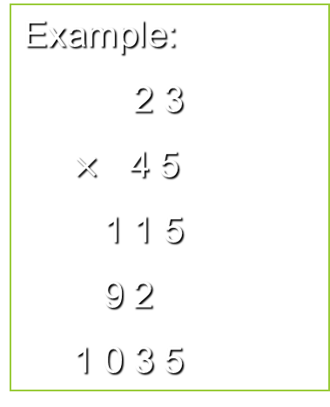
A Divide-and-Conquer Algorithm
Example:
2 3
$×$ 4 5
1 1 5
9 2
1 0 3 5
A = A₁ A₀ B = B₁ B₀
A ∗ B = A₁ ∗ B₁·10^{n} + (A₁ ∗ B₀ + A₀ ∗ B₁) ·10^{n/2} + A₀ ∗ B₀ (1)
The idea is to decrease the number of multiplications from 4 to 3:
(A₁ + A₀ ) ∗ (B₁ + B₀ ) = A₁ ∗ B₁ + (A₁ ∗ B₀ + A₀ ∗ B₁) + A₀ ∗ B_{0,} (2) Therefore: (A₁ ∗ B₀ + A₀ ∗ B₁) = (A₁ + A₀ ) ∗ (B₁ + B₀ ) - A₁ ∗ B₁ – A₀ ∗ B_{0,} (3) which requires only 3 multiplications at the expense of (4-1)
extra add/sub.
A = A₁ A₀ = 23 B = B₁ B₀ = 45
A ∗ B = 2 ∗ 4 ·10² + (2 ∗ 5 + 3 ∗ 4) · 10 + 3 ∗ 5
= 8 ·10² + 22 · 10 + 15
= 800 + 220 + 15
= 1035

Slide 36
A Divide-and-Conquer Algorithm
A = A₁ A₀ B = B₁ B₀
A ∗ B = A₁ ∗ B₁·10^{n} + (A₁ ∗ B₀ + A₀ ∗ B₁) ·10^{n/2} + A₀ ∗ B₀ (1)
The idea is to decrease the number of multiplications from 4 to 3:
(A₁ + A₀ ) ∗ (B₁ + B₀ ) = A₁ ∗ B₁ + (A₁ ∗ B₀ + A₀ ∗ B₁) + A₀ ∗ B_{0,} (2) Therefore: (A₁ ∗ B₀ + A₀ ∗ B₁) = (A₁ + A₀ ) ∗ (B₁ + B₀ ) - A₁ ∗ B₁ – A₀ ∗ B_{0,} (3) which requires only 3 multiplications at the expense of (4-1) extra add/sub.
(w + X) ∗ (Y + Z) = W ∗ Y + W ∗ Z + X ∗ Y + X ∗ Z
= W ∗ Y + (W ∗ Z + X ∗ Y) + X ∗ Z (A)
(W ∗ Z + X ∗ Y) = (w + X) ∗ (Y + Z) - W ∗ Y - X ∗ Z (B)

Slide 37
A Divide-and-Conquer Algorithm
A = A₁ A₀ B = B₁ B₀
A ∗ B = A₁ ∗ B₁·10^{n} + (A₁ ∗ B₀ + A₀ ∗ B₁) ·10^{n/2} + A₀ ∗ B₀ (1)
The idea is to decrease the number of multiplications from 4 to 3:
(A₁ + A₀ ) ∗ (B₁ + B₀ ) = A₁ ∗ B₁ + (A₁ ∗ B₀ + A₀ ∗ B₁) + A₀ ∗ B_{0,} (2) Therefore: (A₁ ∗ B₀ + A₀ ∗ B₁) = (A₁ + A₀ ) ∗ (B₁ + B₀ ) – A₁ ∗ B₁ – A₀ ∗ B_{0,} (3) which requires only 3 multiplications at the expense of (4-1) extra add/sub.
A ∗ B = A₁ ∗ B₁·10^{n} + (A₁ ∗ B₀ + A₀ ∗ B₁) ·10^{n/2} + A₀ ∗ B₀ (1)
= A₁ ∗ B₁·10^{n} + ((A₁ + A₀ ) ∗ (B₁ + B₀ ) – A₁ ∗ B₁ – A₀ ∗ B₀) ·10^{n/2} + A₀ ∗ B₀ (4)

Slide 38

A Divide-and-Conquer Algorithm (cont.)
A ∗ B = A₁ ∗ B₁·10^{n} + ((A₁ + A₀ ) ∗ (B₁ + B₀ ) – A₁ ∗ B₁ – A₀ ∗ B₀) ·10^{n/2} + A₀ ∗ B₀ (4)
$A= A_{1}A_{0}$, $B=B_{1}B_{0}$, n = 2
$C=A∗B=C_{2}∗{10}^{2}+C_{1}∗{10}^{1}+C_{0}$
where $C_{2}=A_{1}∗B_{1}$, $C_{0}=A_{0}∗B_{0}$, $C_{1}=\left(A_{1}+A_{0}\right)∗\left(B_{1}+B_{0}\right)−(C_{2}+C_{0})$
Example: $A= A_{1}A_{0}=52$, $B=B_{1}B_{0}=37$, $n=2$
$C=A∗B=52∗37$
$C_{2}=A_{1}∗B_{1}=5∗3=15$, $C_{0}=A_{0}∗B_{0}=2∗7=14$,
$C_{1}=\left(A_{1}+A_{0}\right)∗\left(B_{1}+B_{0}\right)−(C_{2}+C_{0})$ $=($5 + 2) $∗$ (3 + 7) – (15 + 14) = 7 $∗$ 10 – 29 = 41
$C=15\text{·}{10}^{2}+41\text{·}{10}^{1}+14=1924$

Slide 39

A Divide-and-Conquer Algorithm (cont.)
$A= A_{1}A_{0}$, $B=B_{1}B_{0}$
$C=A∗B=C_{2}∗{10}^{n}+C_{1}∗{10}^{n/2}+C_{0}$
where $C_{2}=A_{1}∗B_{1}$, $C_{0}=A_{0}∗B_{0}$, $C_{1}=\left(A_{1}+A_{0}\right)∗\left(B_{1}+B_{0}\right)−(C_{2}+C_{0})$
Example: $A= A_{1}A_{0}=5216$, $B=B_{1}B_{0}=3748$, $n=4$
$C=A∗B=5216∗3748$
$C_{2}=A_{1}∗B_{1}=52∗37=1924$,
$C_{0}=A_{0}∗B_{0}=16∗48=768$,
$C_{1}=\left(A_{1}+A_{0}\right)∗\left(B_{1}+B_{0}\right)−(C_{2}+C_{0})$
$=($52 + 16) $∗$ (37 + 48) $−$ (1924 + 768) = 68 $∗$ 85 $−$ 2792 = 3088
$C=1924∗{10}^{4}+3088∗{10}^{2}+768=19549568$

Slide 40

Efficiency Analysis: Recurrence and Solution
$M\left(n\right)=3M\left(\frac{n}{2}\right), M\left(1\right)=1$
$n=2^{k}$
$M\left(n\right)=3M\left(\frac{n}{2}\right)$ [Sub. $M\left(\frac{n}{2}\right)=3M(\frac{n}{4})$]
$=3\left[3M\left(\frac{n}{4}\right)\right]=3^{2}M(\frac{n}{2^{2}})$ [Sub. $M\left(\frac{n}{4}\right)=3M(\frac{n}{8})$]
${=3}^{2}\left[3M\left(\frac{n}{8}\right)\right]=3^{3}M(\frac{n}{2^{3}})$
$M\left(n\right)= 3^{i}M(\frac{n}{2^{i}})$
$i=k$, $k=\log_{2}{n}$
$M\left(n\right)= 3^{k}M\left(\frac{n}{2^{k}}\right)=3^{k}$
$M\left(n\right)=3^{k}=3^{\log_{2}{n}}=n^{\log_{2}{3}}≈n^{1.585}$

Slide 41

Using the Master Theorem
T(n) = aT(n/b) + f (n)
where f(n) ∈ Θ(n^{d}), d ≥ 0
Master Theorem:
If a < b^{d}, T(n) ∈ Θ(n^{d})
If a = b^{d}, T(n) ∈ Θ(n^{d} log n)
If a > b^{d}, T(n) ∈ Θ(n^{log b a} )
$M\left(n\right)=3M\left(\frac{n}{2}\right), M\left(1\right)=1$
$a=3$, $b=2$, $d=0$
$a=3 >b^{d}=2^{0}=1$
$M\left(n\right)∈\text{Θ}\left(n^{\log_{b}{a}}\right)=\text{Θ}{(n}^{\log_{2}{3}})$
$≈\text{Θ}{(n}^{1.585})$

Slide 42
Strassen’s Matrix Multiplication
Strassen observed [1969] that the product of two matrices can be computed as follows:
C₀₀ C₀₁ A₀₀ A₀₁ B₀₀ B₀₁
= *
C₁₀ C₁₁ A₁₀ A₁₁ B₁₀ B₁₁
M₁ + M₄ - M₅ + M₇ M₃ + M₅
=
M₂ + M₄ M₁ + M₃ - M₂ + M₆
(1)
(2)

Slide 43
Formulas for Strassen’s Algorithm
M₁ = (A₀₀ + A₁₁) ∗ (B₀₀ + B₁₁)
M₂ = (A₁₀ + A₁₁) ∗ B₀₀
M₃ = A₀₀ ∗ (B₀₁ - B₁₁)
M₄ = A₁₁ ∗ (B₁₀ - B₀₀)
M₅ = (A₀₀ + A₀₁) ∗ B₁₁
M₆ = (A₁₀ - A₀₀) ∗ (B₀₀ + B₀₁)
M₇ = (A₀₁ - A₁₁) ∗ (B₁₀ + B₁₁)

Slide 44
Analysis of Strassen’s Algorithm
If n is not a power of 2, matrices can be padded with zeros.
Number of multiplications:
M(n) = 7M(n/2) (1)
M(1) = 1 (2)
Solution: M(n) = 7^{log 2n} = n^{log 27} ≈ n^{2.807} vs. n³ of brute-force alg.
Algorithms with better asymptotic efficiency are known but they
are even more complex.

Slide 45
Design techniques and problem types
 | Search | Sorting | Tree | Graph | Other
Brute force, exhaustive search | Sequential search, Sequential string match | Selection sort, Bubble sort |  | Traveling salesman problem, DFS, BFS | Knapsack problem, Assignment problem
Decrease and conquer | Binary search | Insertion sort | Binary search tree | Topological sorting | Exponentiation by squaring
Divide and conquer |  | Mergesort, Quicksort | Binary tree traversal |  | Matrix multiplication, Large integer multiplication, quickhull
Transform and conquer | Presorting | Heapsort | AVL tree, 2-3 tree |  | Gaussian elimination, Polynomial evaluation
Space and time tradeoff | Hashing, B-tree, Horspool algorithm | Sorting by counting
Dynamic programming |  |  | Optimal binary search trees | Warshall’s algorithm, Shortest paths problem | Knapsack problem, Memory functions
Greedy techniques |  |  |  | Minimum spanning tree | Huffman trees
Iterative improvement |  |  |  | Maximum flow Bipartite graphs | Stable marriage problem
Backtracking Branch & bound |  |  |  | Traveling salesman problem, | N-queens, Assignment, Knapsack

Slide 46
Recommended Reading
5.1
5.2
5.3
5.4
5.5

